Slide 1



Rose Leaf Disease Detection
Proposed By:
Tasnia Sharmin
Mounika Davuluri

Slide 2

Introduction
Rose cultivation is a practice deeply embedded in horticulture and landscaping, appreciated for its aesthetic appeal and symbolic significance. However, the health and vitality of roses are threatened by various diseases that can hinder their growth and diminish their beauty. Among these afflictions, leaf diseases pose a significant challenge to rose growers, as they not only affect the plant's aesthetics but also compromise its overall health and productivity.
The conventional methods of disease detection in rose leaves often rely on visual inspection by experts, which can be time-consuming, subjective, and prone to human error. With the advent of advanced technologies in computer vision and machine learning, there has been a notable shift towards automating the detection and diagnosis of plant diseases, including those affecting rose leaves.

Slide 3

The proliferation of rose leaf diseases poses a significant challenge to rose growers, necessitating efficient detection methods. Leveraging Convolutional Neural Networks (CNNs), this study aims to automate rose leaf disease detection, offering a solution to the limitations of traditional manual inspection methods. By harnessing the deep learning capabilities of CNNs, we strive to develop a precise and reliable system for early disease identification.
This research endeavors to revolutionize rose cultivation practices by providing growers with timely insights for effective disease management. Through the integration of advanced technology, we seek to enhance the health and productivity of roses, contributing to sustainable horticulture practices worldwide.

Slide 4
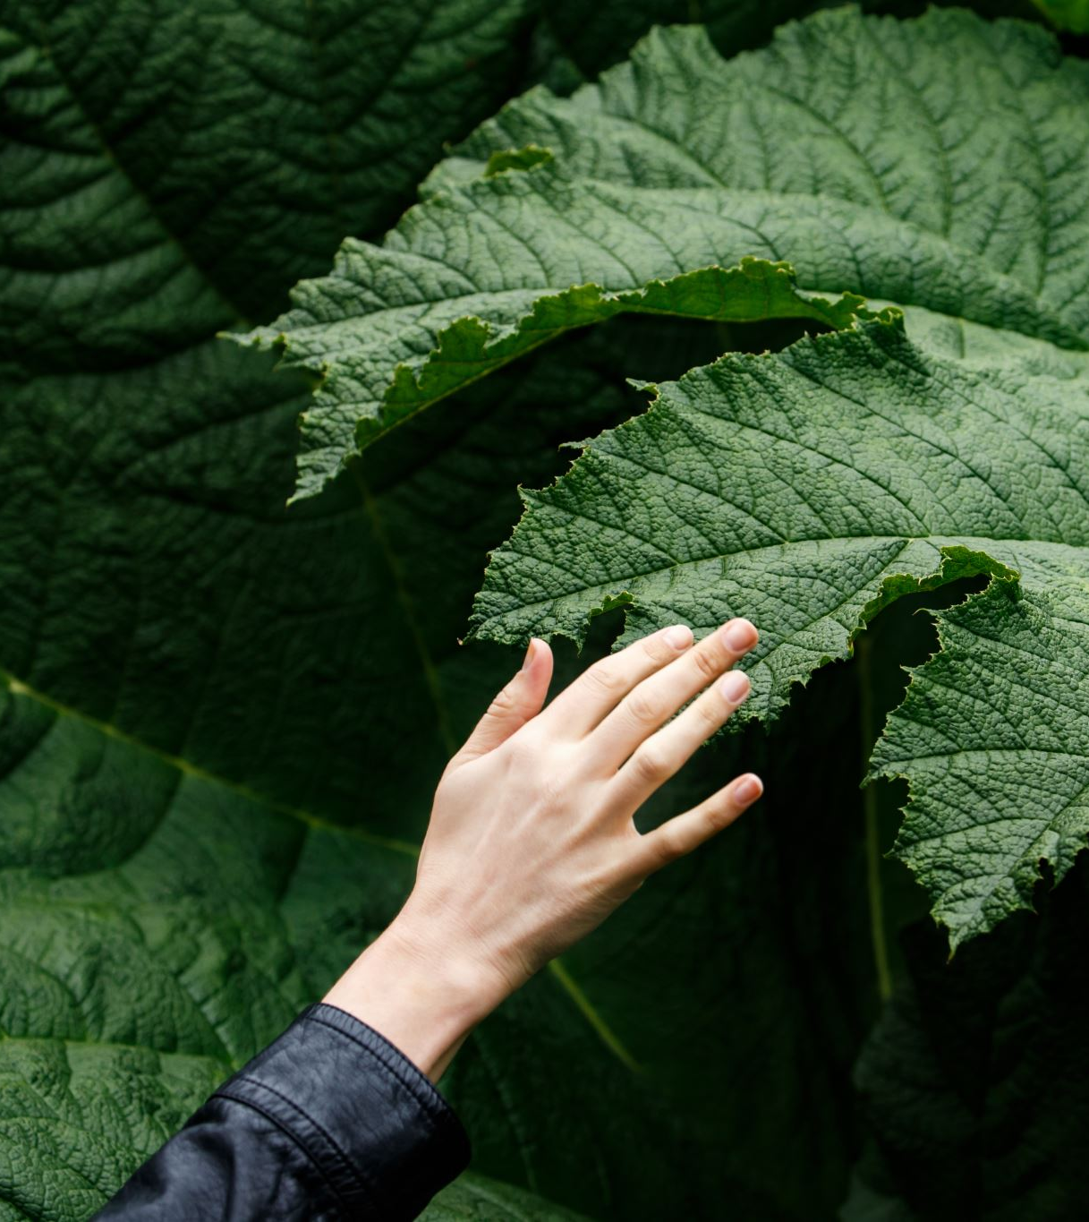
Project Objectives
Building VGG16 and Resnet50 model to accurately detect disease in rose plant leaves.
Comparison between these two model.
Achieving higher accuracy in disease detection on rose plant.
Enhance rose yield and quality through timely disease detection.

Slide 5
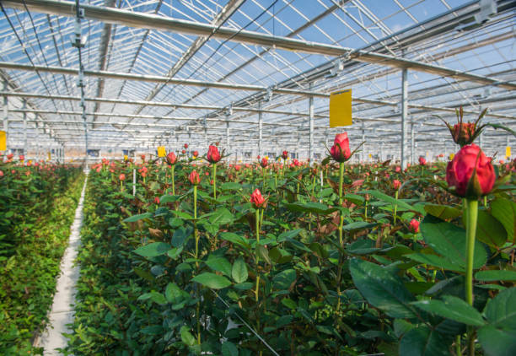
Statement of value
Early detection of leaf diseases in rose plants can prevent loss and improve agricultural productivity.
The model can assist farmers and agricultural experts in diagnosing diseases in rose plants more effectively.
.

Slide 6

Approach
We will use Kaggle data for rose leaf disease detection. The source of data is given below: https://www.kaggle.com/datasets/warcoder/rose-leaves-disease-detection
The dataset has three classes: disease free leaves, and two rose diseases: black spot and downy mildew.
The dataset consists 917 photos so we need to do data augmentation.

Slide 7

Hierarchy
Dataset
Data Augmentation
Image Pre-Processing
Model Building Using
VGG16 & ResNet50
Evaluation

Slide 8
DATASET CLASSIFICATION:
DATASET
Black Spot
Downy Mildew
Fresh Leaf

Slide 9
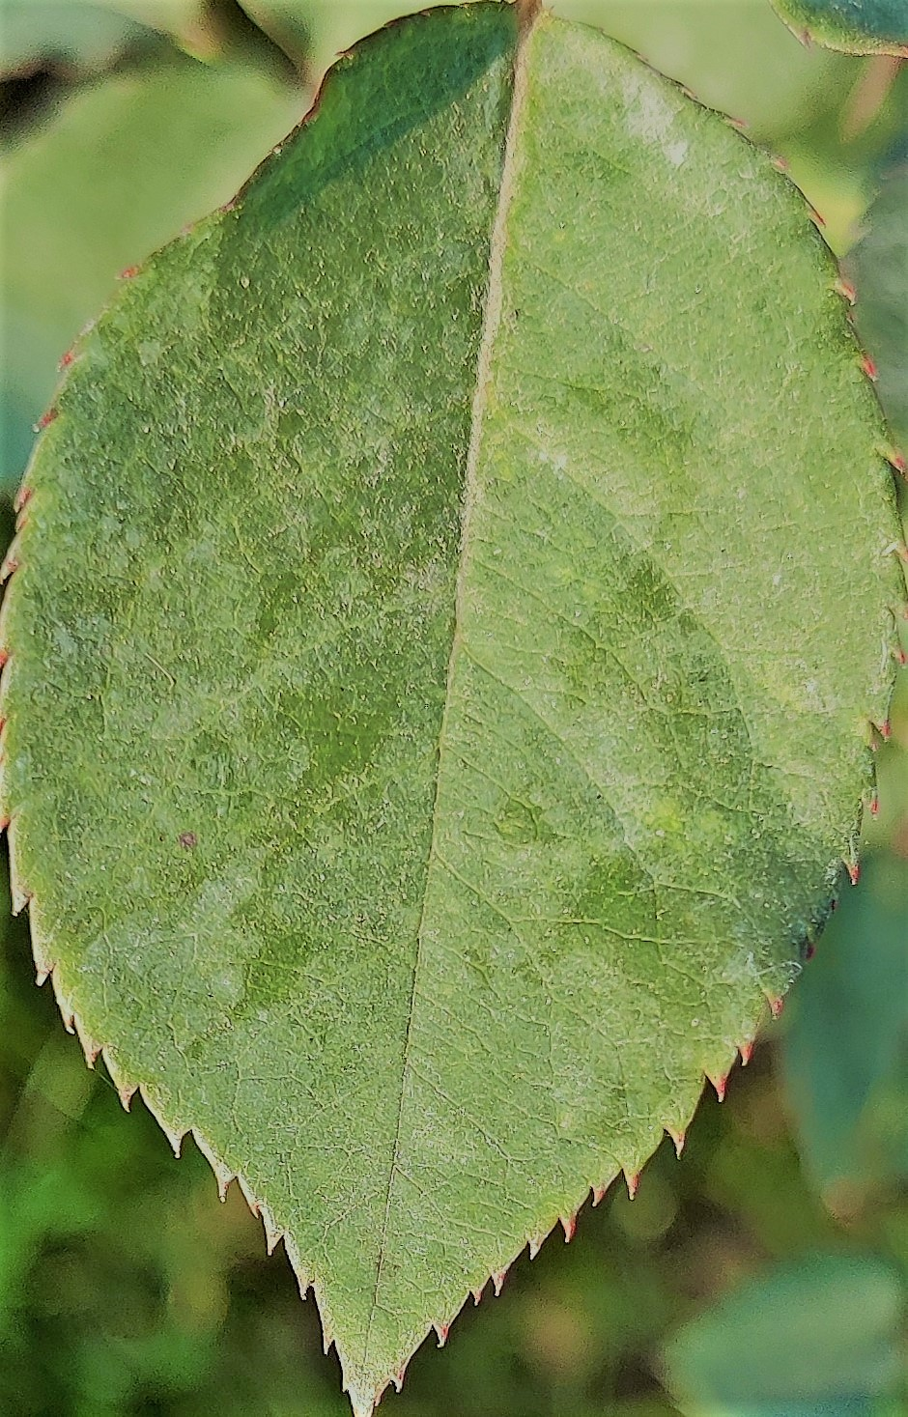
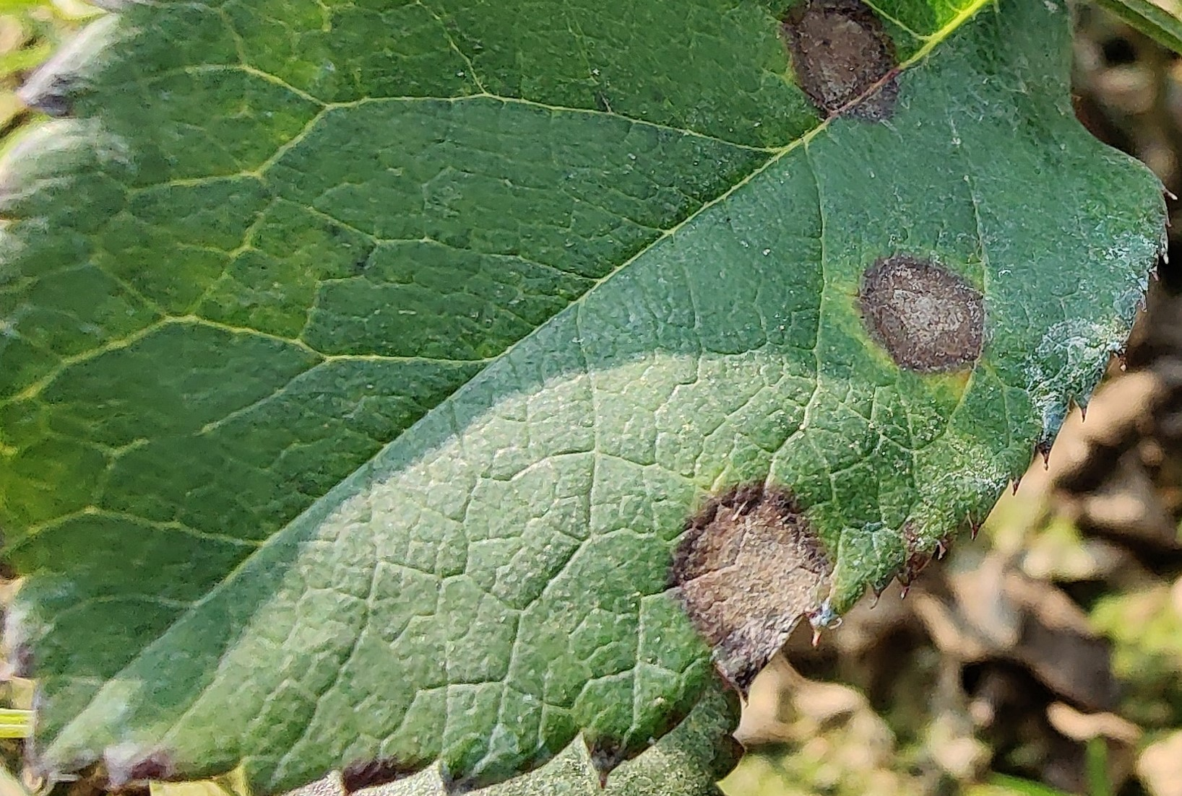
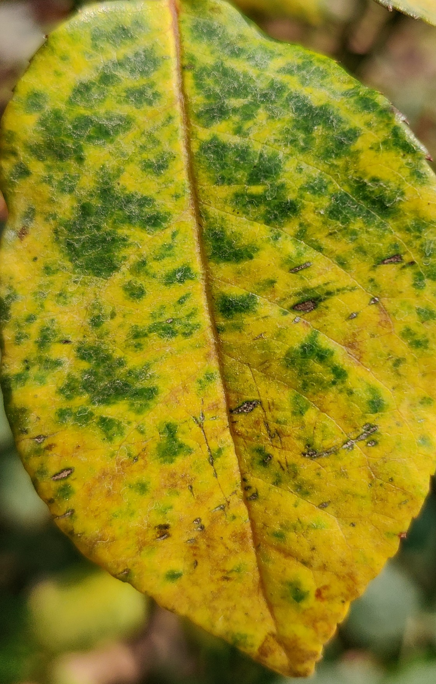
Fresh Leaf, Black Spot, Downy Mildew Visuals:

Slide 10
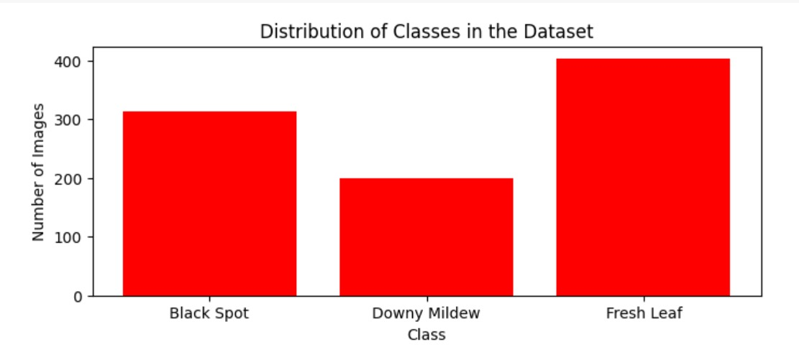
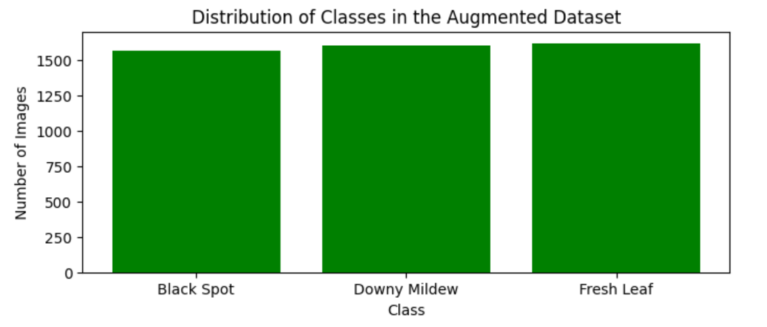
Graphical Representation of Data:

Slide 11
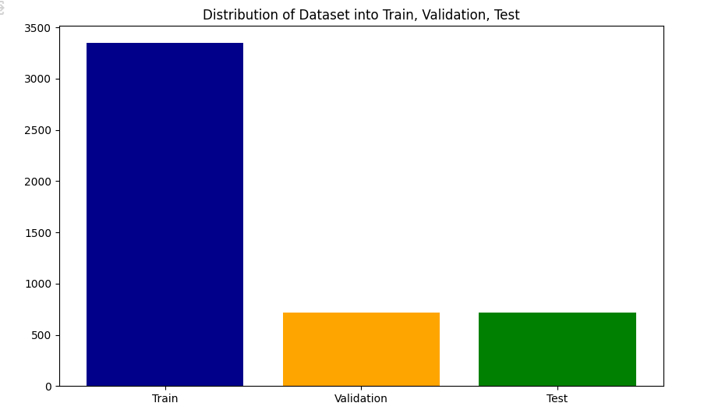
Split into Train, Test and Validation

Slide 12
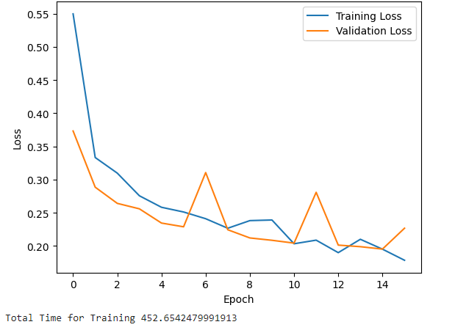
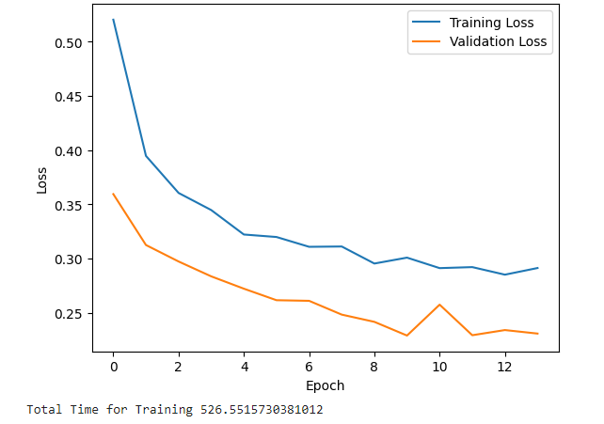
ResNet50 Model VS VGG16

Slide 13
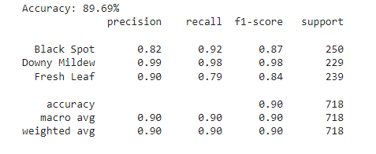
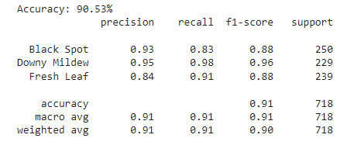
Output: ResNet50 VS VGG16

Slide 14
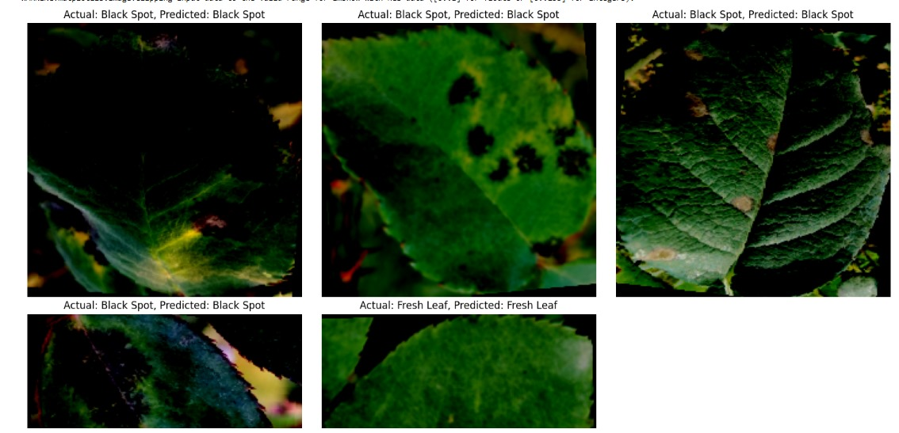
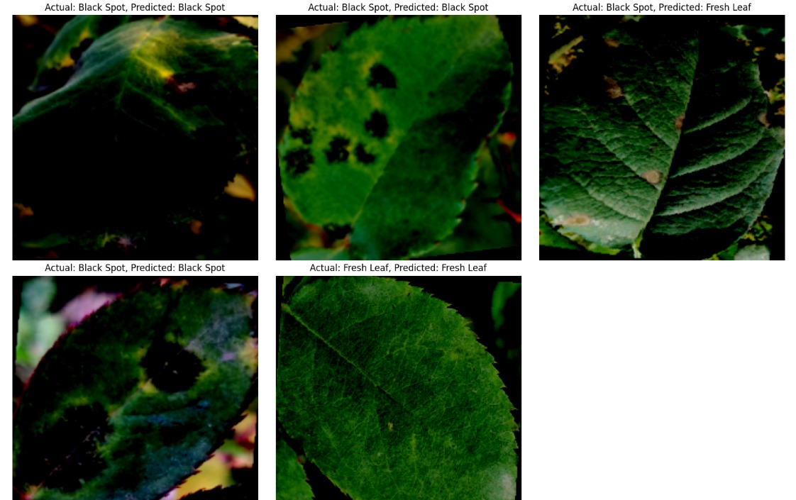
Predicted Output: ResNet50 VS VGG16

Slide 15

Conclusion
Overall ResNet50 is more accurate(89.69%) compared to VGG16(90.53%).
The training time for VGG16 exceeded that of ResNet50.
For the “Fresh leaf" class, ResNet50 has higher precision (90%) compared to Vgg16(84%).
The F1-scores for both models are quite similar across all classes, with VGG16 slightly outperforming ResNet50 in some cases.
For “Fresh Leaf” class VGG16(91%)has higher recall compare to ResNet50 (79%).

Slide 16


